Slide 1
ENIAC: Expansion to the Brazilian Market
The Collaboration Project with MAGIST

Slide 2
ENIAC vs MAGIST
Revenue: €14M
Revenue: €12M
Avg. monthly revenue: €1.17M
Avg. monthly revenue: €0.99M
Avg. order price: €710
Avg. TECH order price: €170
Avg. item price: €540
Avg. TECH item price: €110

Slide 3
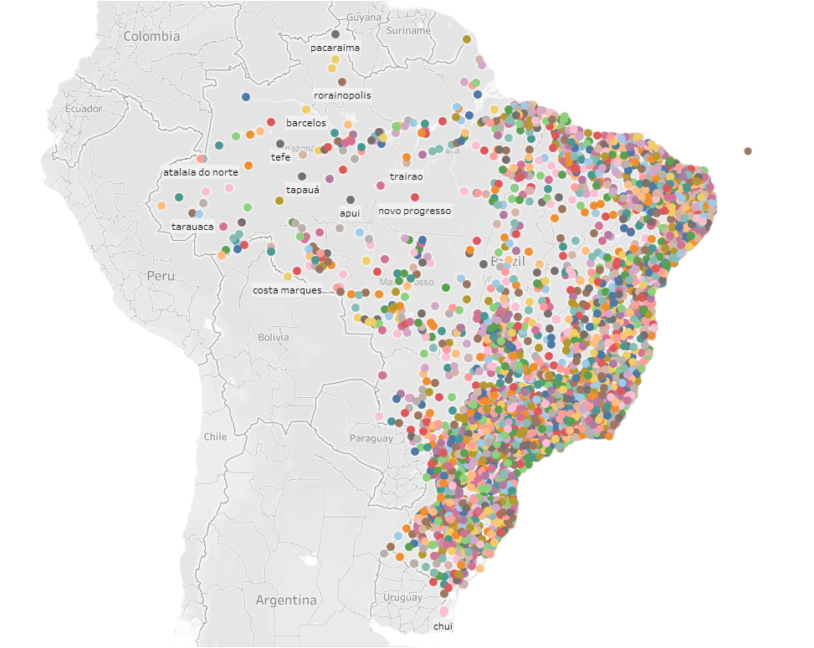
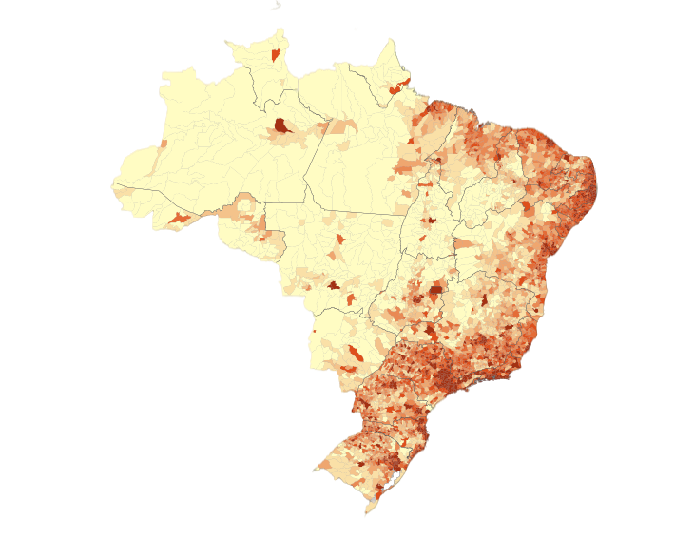
Brazil’s Population Density
https://en.m.wikipedia.org/wiki/File:Population_density_Brazil_2020.svg
MAGIST has a good coverage of Brazilian Market

Slide 4
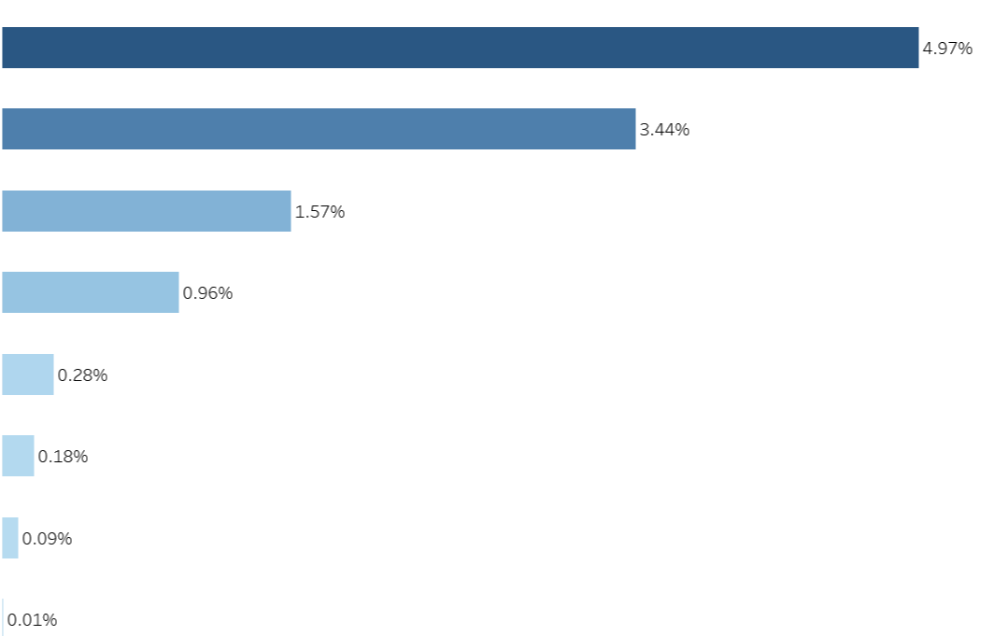
Computer
Accessories
Telefonica
Electronics
Console Games
MAGIST has 32951 products in 75 different categories and only 11% similar to ENIAC products.
Signaling and
Security
Audio
Computers
PC Gamer

Slide 5
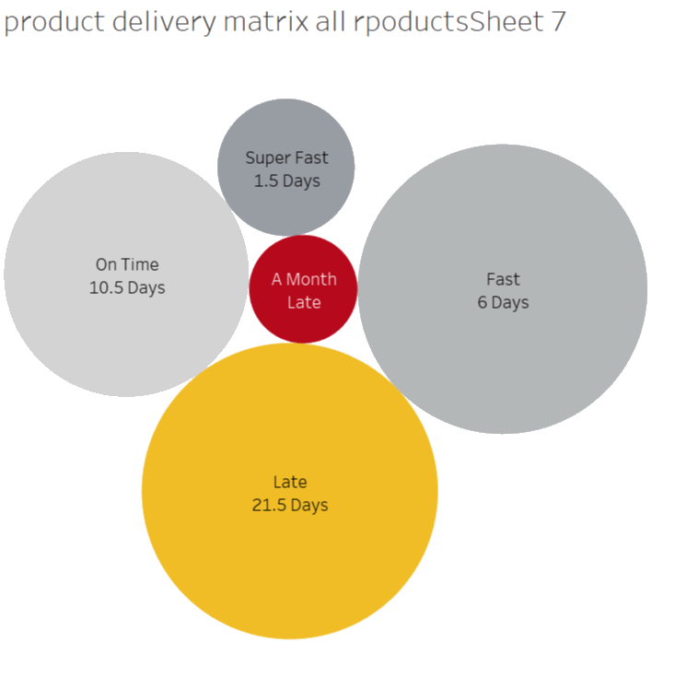
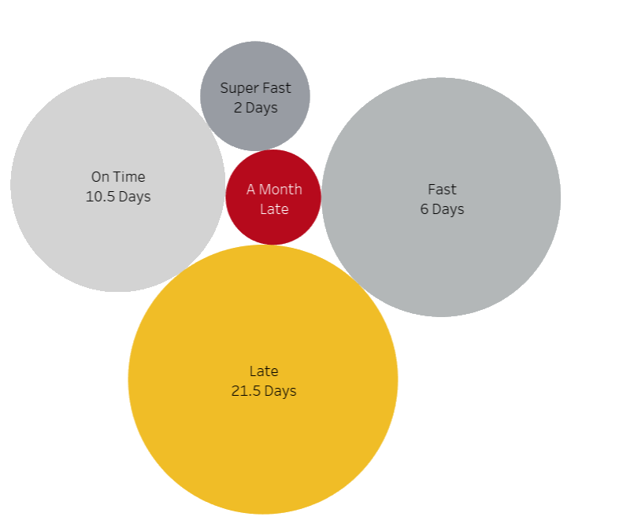
Deliveries are late with MAGIST
35%
40%
Average Delivery Time 12 Days
(for all products)
Average Delivery Time 13 Days
(for Tech-Products)

Slide 6
MAGIST
Pros:
Good logistic coverage
Cheap delivery fees
Good understanding of the brazilian market
Cons:
Only 11% of Tech products (revenue 0.25M)
High delivery time - average: 12-13 days
Not specialized in dealing with one branch - too many diverse, unrelated products
The products that line up with Eniac products are only a fraction

Slide 7
Eniac’s Own Test Project In Brazil
A Time/Cost Analysis
Comparative Cost/Benefit Analysis

Slide 8
Thank you!
Afsheen Shahid
Abdessamad Bousmara
Samuel Magda

